Slide 1
NAAN MUDHALVAN
FLIGHT BOOKING APP
PRESENTED BY
ARVINTH N D - 310821104014
DHAMODHARAN V C - 310821104023
HARESH V - 310821104033
LOGESHWARAN M - 310821104049

Slide 2
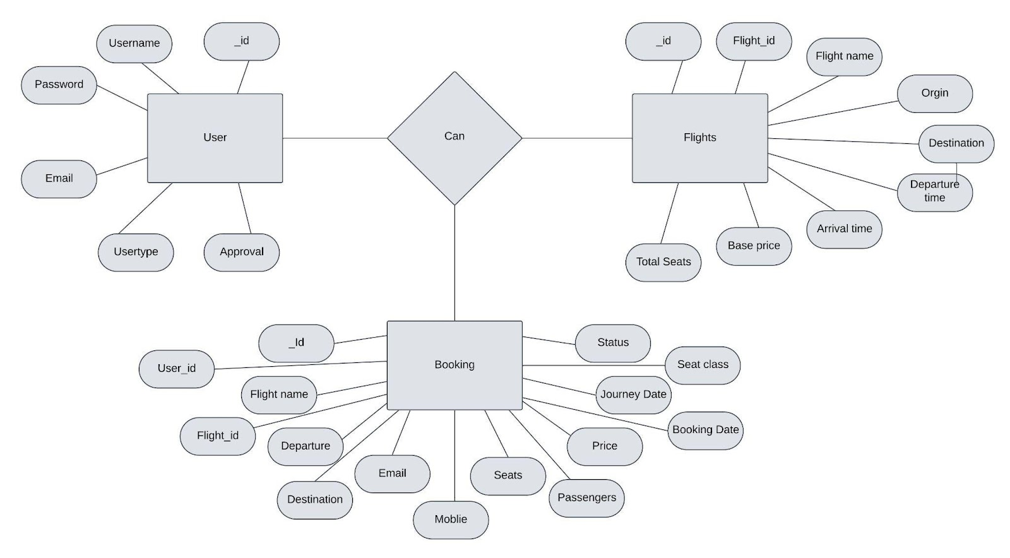
PROJECT ARCHITECTURE

Slide 3
This Flight Booking APP is the ultimate digital platform designed to revolutionize the way you book flight tickets.
With this app your flight travel experience will be elevated to new heights of convenience and efficiency.
Our user-friendly web app empowers travelers to effortlessly discover, explore, and reserve flight tickets based on their unique preferences.
Whether you're a frequent commuter or an occasional traveler, finding the perfect flight journey has never been easier.
This successful flight booking app combines a user-friendly interface, efficient search and booking capabilities, personalized features, robust security measures, reliable performance, and continuous improvement based on user feedback.

Slide 4
TECHNICAL ARCHITECTURE
The frontend is represented by the "Frontend" section, including user interface components such as User Authentication, Flight Search, and Booking.
The backend is represented by the "Backend" section, consisting of API endpoints for Users, Flights, Admin and Bookings.
It also includes Admin Authentication and an Admin Dashboard.
The Database section represents the database that stores collections for Users, Flights, and Flight Bookings.

Slide 5
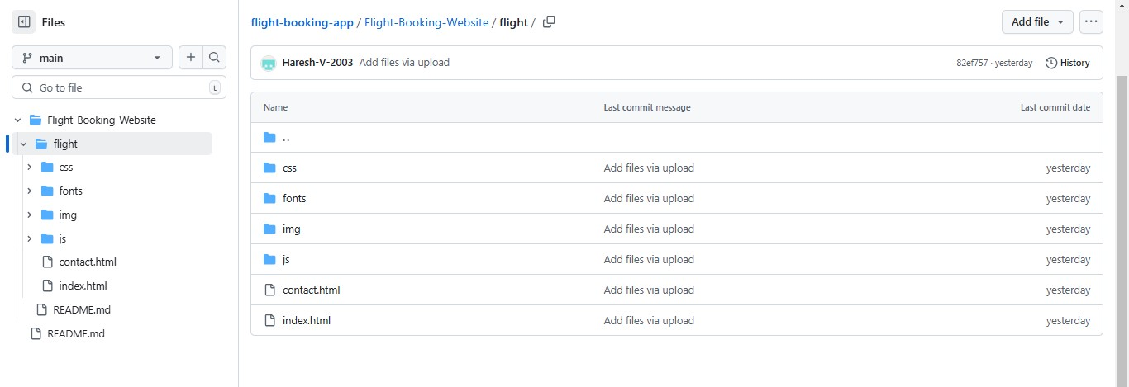
PROJECT LINK AND SUB-DIRECTORY STRUCTURE

Slide 6
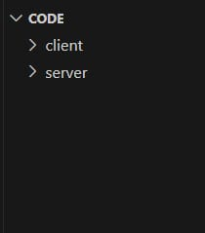
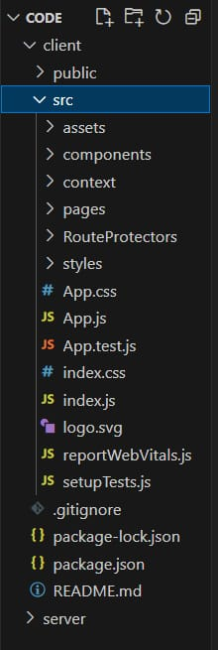
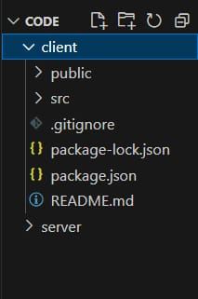
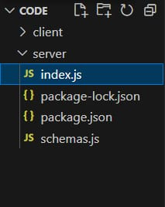

Slide 7
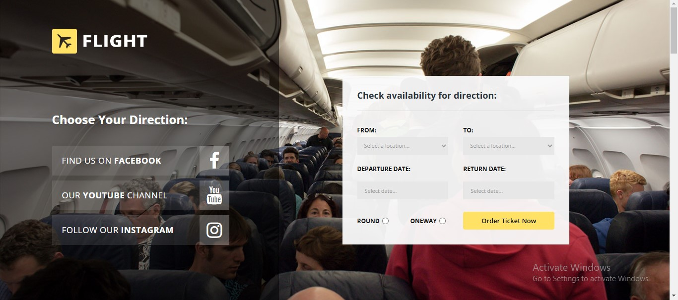
THE END PROJECT

Slide 8
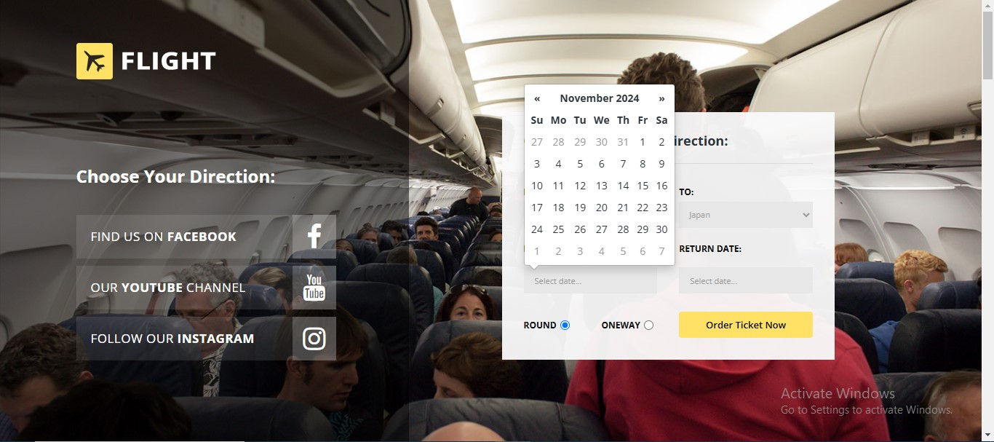
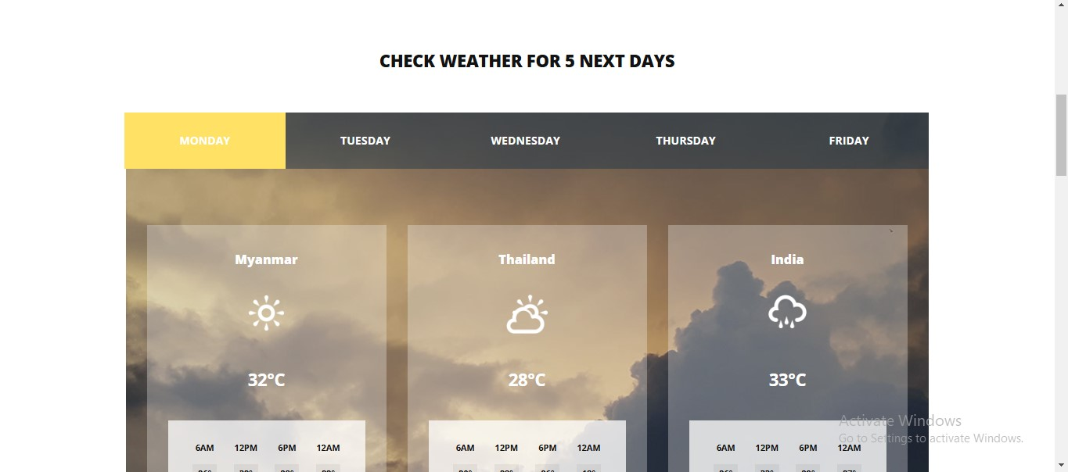

Slide 9
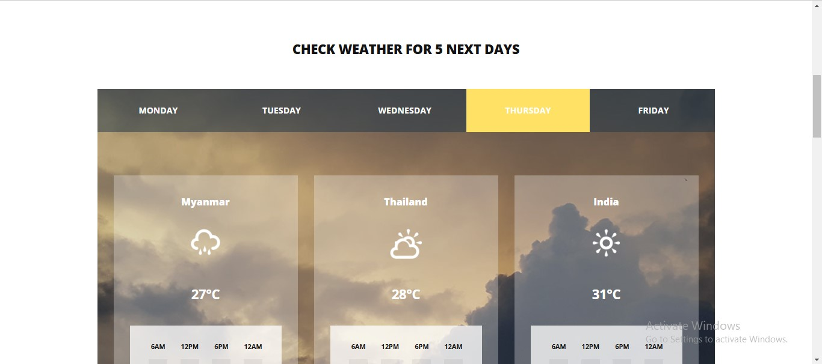
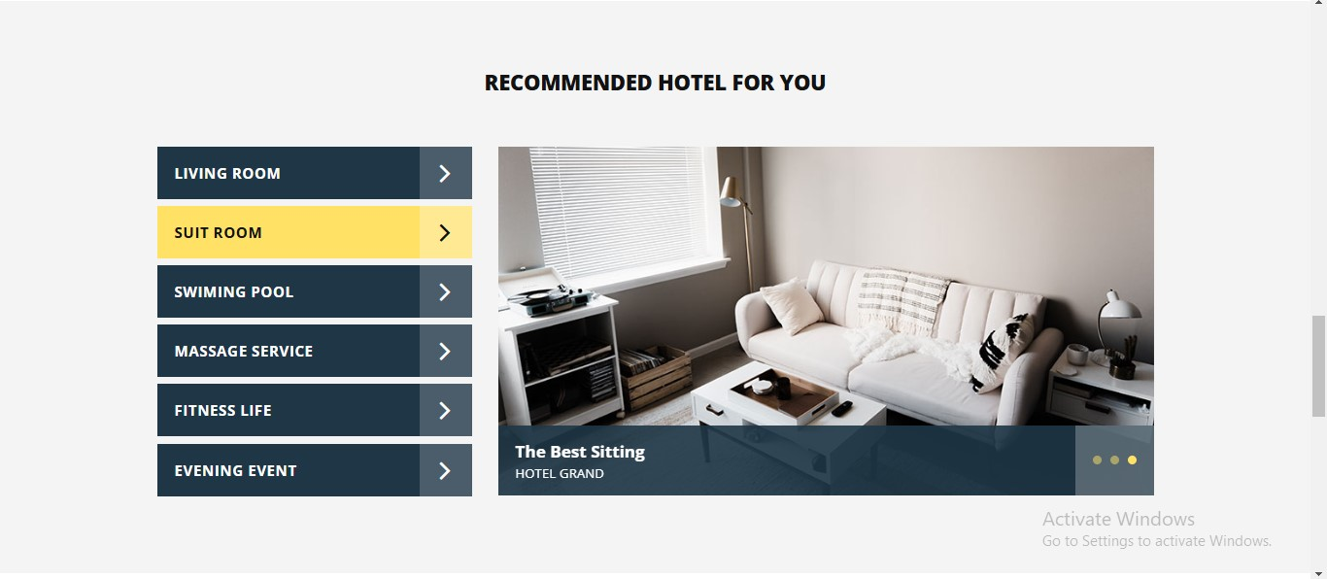

Slide 10
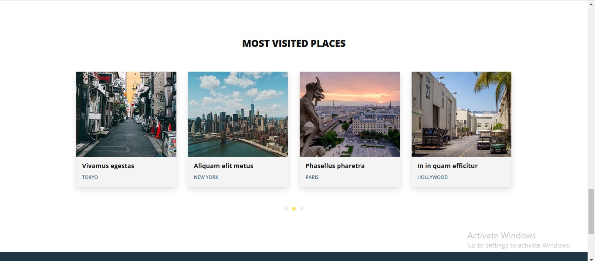

Slide 11
INSTALLING DEPENDENCIES
Initialize the Node.js Application:
mkdir
flight-booking-app
cd flight-booking-app
npm init -y
This generates a package.json file to manage dependencies.
Install Required Packages:
npm install express
mongoose body-parser
dotenv nodemon
express: For creating REST APIs.
mongoose: For MongoDB object modeling.
body-parser: To parse incoming request bodies.
dotenv: For managing environment variables.
nodemon: For automatically restarting the server during development.

Slide 12
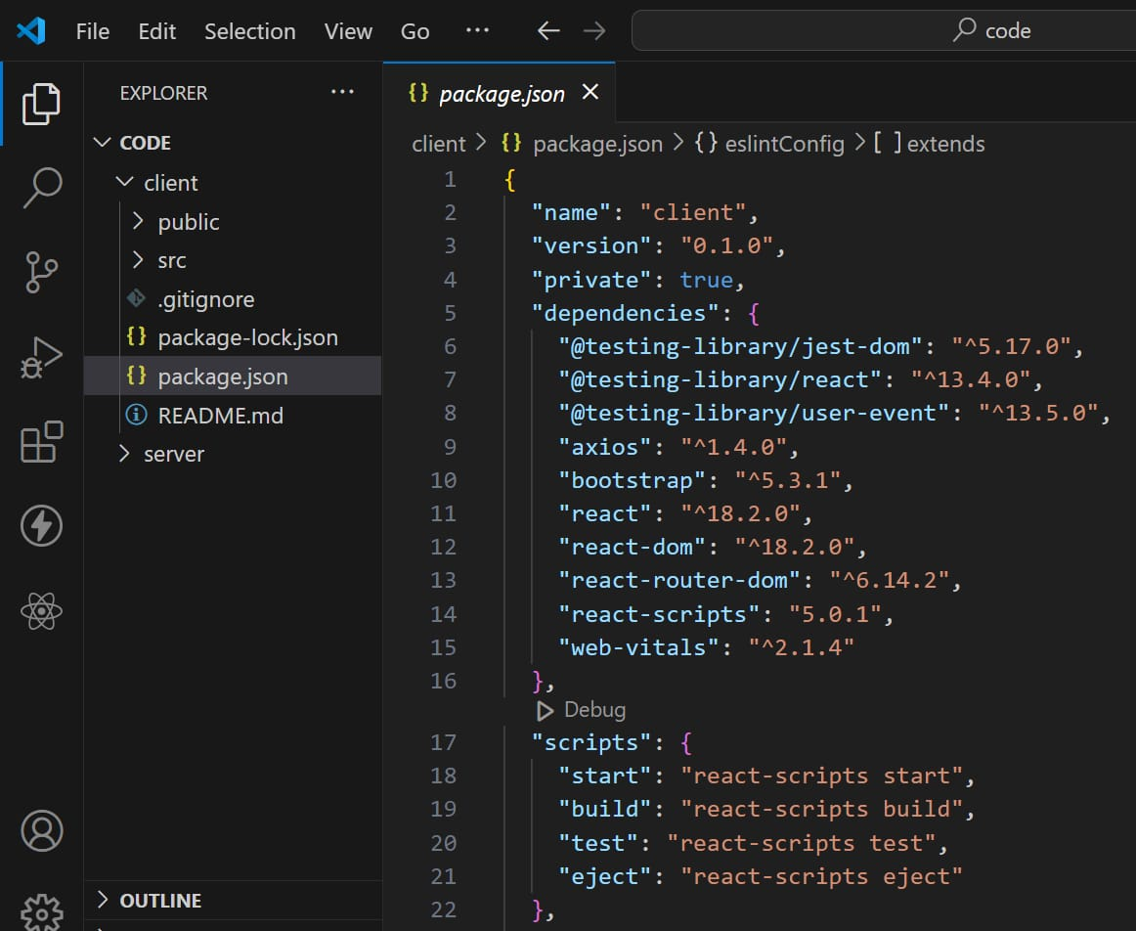
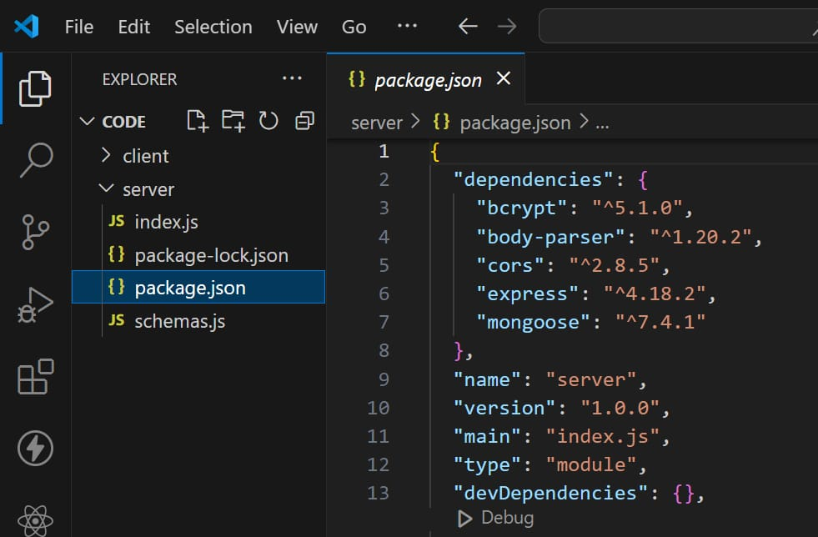

Slide 13
INITIALIZING BACKEND IN NODE JS
Initializing backend in node js and connecting it with the database in port 6001
Setup Express Server: Example: server.js
const express = require('express');
const bodyParser = require('body-parser');
const dotenv = require('dotenv');
const db = require('./db');
dotenv.config();
const app = express();
app.use(bodyParser.json());
app.get('/', (req, res) => {
res.send('Flight Booking App Backend');
});
const PORT = process.env.PORT || 5000;
app.listen(PORT, () => {
console.log(`Server running on port ${PORT}`);
});

Slide 14
INITIALIZING DATABASE IN MONGODB
Setup MongoDB Server:
Install MongoDB locally or use a cloud service.
Example:MongoDB Atlas
Create a database named flight_booking.
Create a Database Schema: Example: models/Flight.js
const mongoose = require('mongoose');
const FlightSchema = new mongoose.Schema({
flightNumber: String,
departure: String,
arrival: String,
price: Number,
date: Date,
});
module.exports = mongoose.model('Flight', FlightSchema);

Slide 15
Database Connection: Example: db.js
const mongoose = require('mongoose');
const dotenv = require('dotenv');
dotenv.config();
mongoose.connect(process.env.MONGO_URI, {
useNewUrlParser: true,
useUnifiedTopology: true,
}).then(() => {
console.log('Connected to MongoDB');
}).catch(err => {
console.error('Database connection error:', err);
});

Slide 16
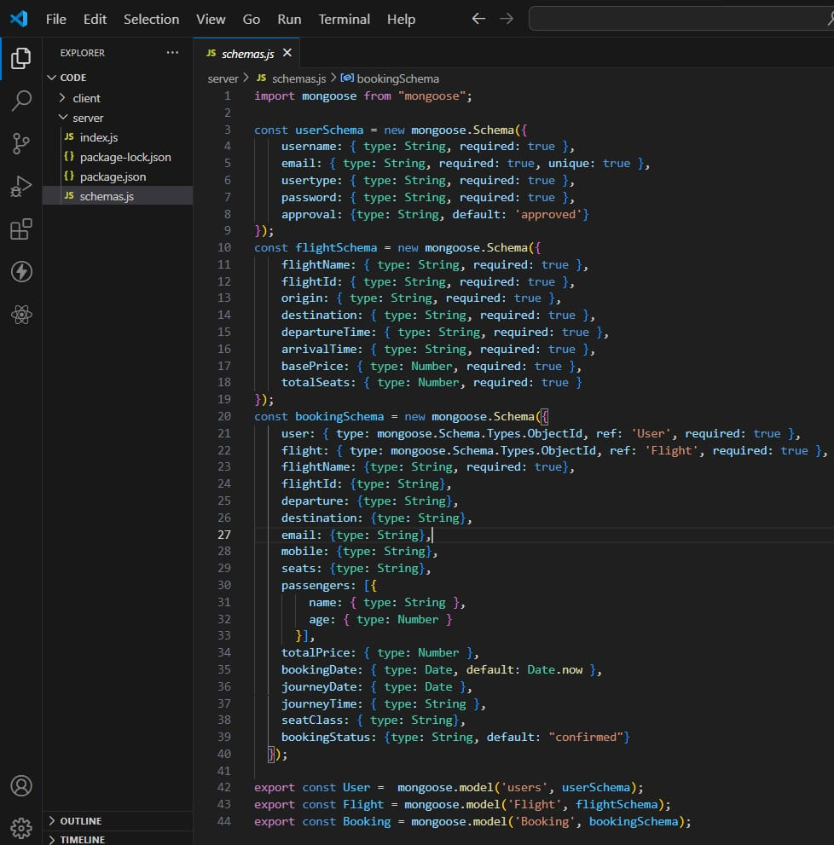

Slide 17
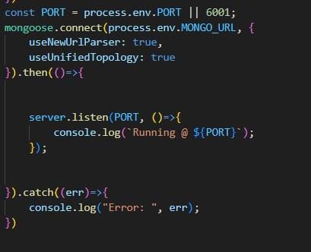
Testing the Backend
Use Postman or cURL to test API endpoints.
Example POST request to add a flight:json
{
"flightNumber": "AB123",
"departure": "New York",
"arrival": "Los Angeles",
"price": 200,
"date": "2024-12-01"
}

Slide 18
Adding Routes for Flight Management: Example: routes/flightRoutes.js
const express = require('express');
const Flight = require('../models/Flight');
const router = express.Router();
router.post('/flights', async (req, res) => {
const flight = new Flight(req.body);
await flight.save();
res.status(201).send(flight);
});
module.exports = router;
Update server.js to use the route:
const flightRoutes = require('./routes/flightRoutes');
app.use('/api', flightRoutes);

Slide 19
THANK YOU

